Slide 1
Krylov.jl

Slide 2
Overview
Described as “A Julia Basket of Hand-Picked Krylov Methods”
Krylov methods are used for solving linear systems of equations Ax = B, linear least-squares problems, and linear least-norm problems.
The package includes ≈48 different Krylov methods with different conditions for matrices, different levels of optimizations, etc.
The package sees use in numerical computation and scientific research. Standard package for when specific/obscure Krylov methods are needed.

Slide 3
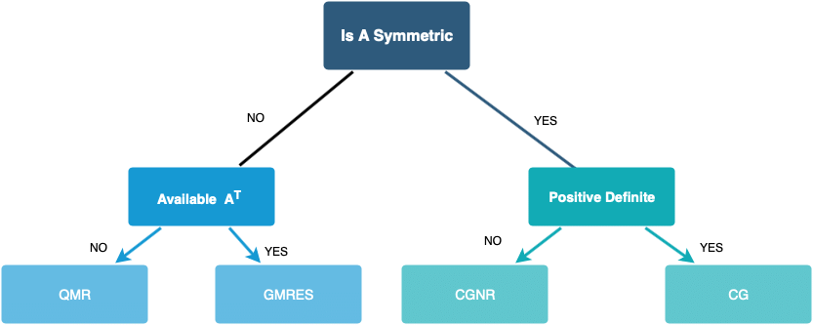
Matrix Conditions

Slide 4
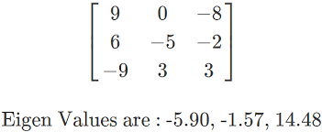
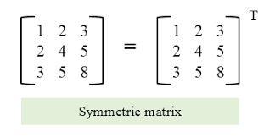
Matrix Conditions (Cont.)
Definition
Shape
Symmetry
Hermitian?
Memory Available?
&
other specific conditions/special matrices

Slide 5
How fast actually are these Krylov methods? Are there further optimizations that exist?

Slide 6
Potential Project:
Measuring the speed of these Krylov methods, finding and applying an optimization to one slow section of the Krylov method.

Slide 7
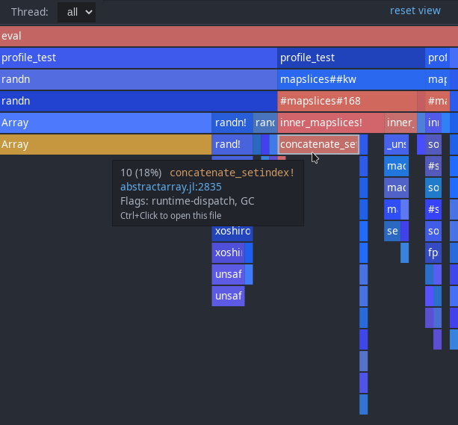
Measuring the Speed
@time: Simple statistics on the runtime of the method
@profile: Provides a flame graph of the function, indicating which function calls and procedures take the most time

Slide 8
Measures of Success
Decrease in total @time runtime.
Optimization of a certain function/procedure call visually indicated in the flame graph.

Slide 9
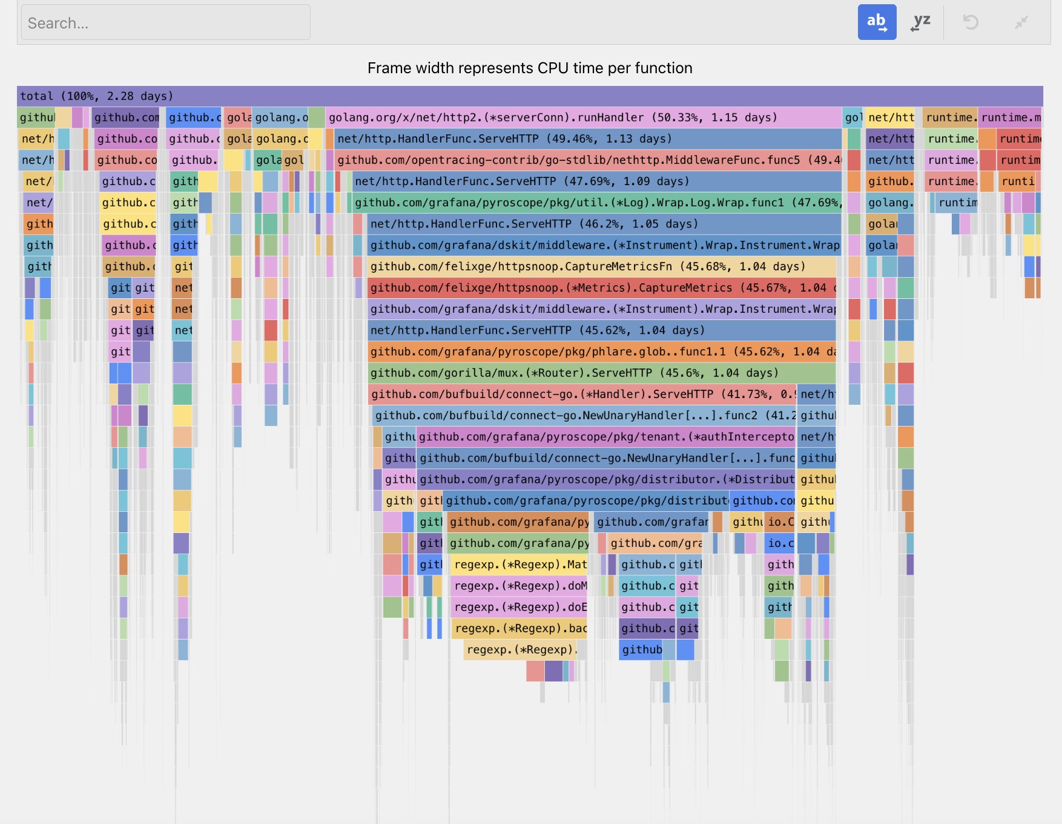
End Result
A visual display of the flame graph before/after indicating improvement
If unable to optimize further, an explanation of why, and how these methods have already been optimized
A pull request on the repository if significant optimization occurred

